Slide 1


Slide 2
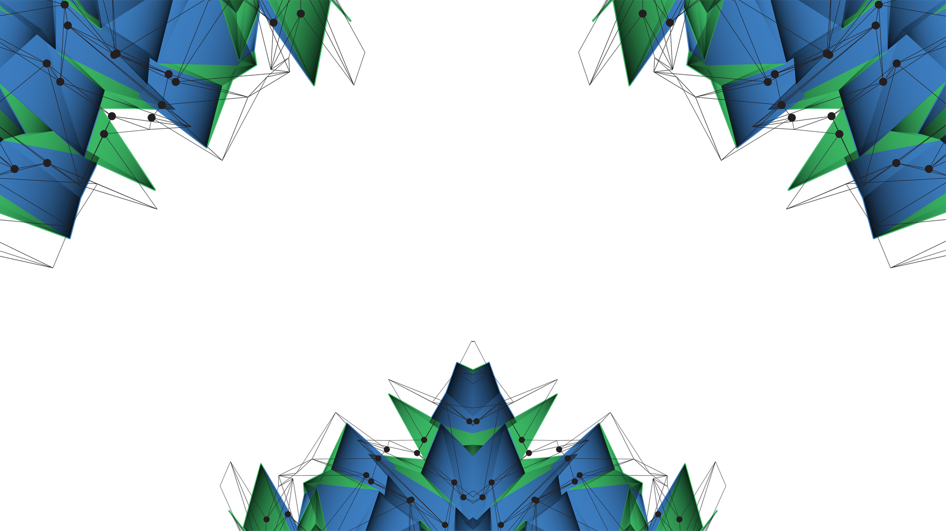
Maximizing Value within the Energy Sector
Proof of concept
Laura Foulquier

Slide 3
Agenda
Big Data for Minimizing Risk
Oil & Gas Insurance - Context
Geomechanics
Well database
Proof of Concept
Well Database Format
End of Well Report Information
Rating drilling events
Example and visualisation
Next Step

Slide 4

I. Big Data for Minimizing Risks Oil & Gas Insurance - Context
2010 Deepwater Horizon accident
Insurance premiums up 25 – 30%
Deepwater drilling premiums up 100%
Lack of understanding:
Energy operations
Current safety procedures on platform
Notes:
11 crew members died
$62 bn estimated total cost for BP in 2016
According to Lancashire , the largest insurer of energy risks
Premiums not predicted efficiently considering the increase of premiums after the disaster. New solution can help building better relationships with customers and facilitate loyalty

Slide 5
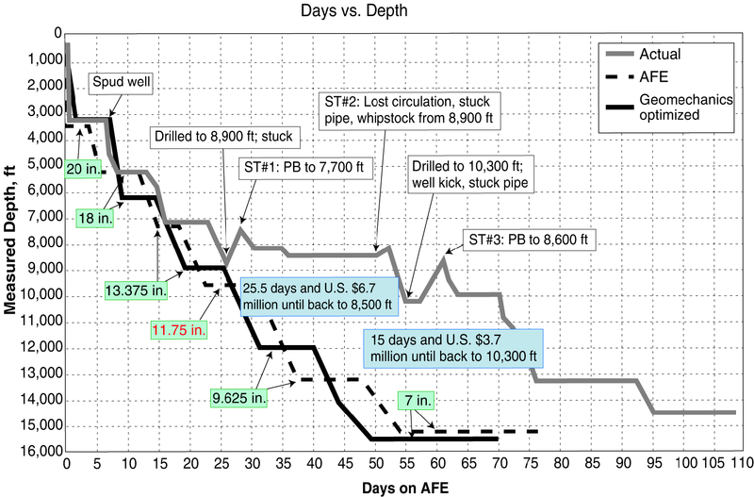
I. Big Data for Minimizing Risks Geomechanics
Geomechanics
Study of rock mechanics
Predict wellbore stability in response to change of stress, pressure, temperature
Optimize planning by predicting drilling events (stuck pipe, inflow, kick)
Minimize risks
Faster drilling operations (50%)
Notes:
AFE : Authority for Expenditures (cost estimates for a well – final step of well planning)
Picture: Moos, D., Peska, P., Finkbeiner, T. et al. 2003. Comprehensive wellbore stability analysis utilizing Quantitative Risk Assessment. J. Pet. Sci. Eng. 38 (3–4): 97-109. http://dx.doi.org/10.1016/s0920-4105(03)00024-x.
How to quantify the likelihood of business interruption or physical damages?
Defining Geomechanics. www.slb.com/defining:
Geomechanics is the study of how rocks deforms sometimes to failure, in response to changes of stress, pressure, temperature and other environmental parameters. Over the last 30 years, geomechanics has come to play an increasingly important role in drilling, completion and production operations. At a wellbore scale, geomechanics is central to understanding how drill bits remove rock, characterizing borehole stability and predicting the stability of perforation tunnels. Engineers use geomechanical modelling to predict and quantify these effects for life-of-reservoir decisions such as placing and completing new wells, minimizing risk and making new investments.

Slide 6

I. Big data for Minimizing Risks Well database
Numerous data
1.7m wells in the U.S.A. in 2015, estimation of 670,000 to be drilled in the world by 2020
Confidentiality limited on time
Between 2 and 10 years
Short term
Use available well data
Drilling: Mud logs, drilling reports
Well logs, seismic, path
Long term
Once value shown, build worldwide database
Example of available database:
Norway: http://www.diskos.no/

Slide 7
II. Proof of Concept Well Database Format
A well database is built containing already-drilled wells and their:
Name
Location
Their “stability” score
Geospatially indexed (faster queries)
The closest to the well-to-be-drilled, the more weight (inversion distance weighting)
Well Name | Northing | Easting | Projection | Basin | Score

Slide 8
II. Proof of concept End of well report information
Available information from End of Well Report
General Information
Well Name
Location (Easting, Northing, Basin)
Drilling summary
Drilling events: losses (minor or major), stuck pipe, pressure kick, blow out, pack off, tight spot, sidetrack
Best practice: Formation integrity test (FIT), reaming , (extended) leak-off test (XLOT)
Notes:
Reaming : cleaning

Slide 9
III. Proof of concept Ranking Drilling events
A well stability can be determined by looking at the different events encountered while drilling
To each drilling event is assigned a score, determined by using machine learning mechanisms
For each well a final score is computed depending on the encountered drilling events and their occurrence
The more negative the final score the less stable the well was
 | Drilling events | Score
Delays Instability | Blowout | - 100
 | Pressure kick | - 20
 | Pack Off | -10
 | Stuck pipe | -10
 | Sidetrack | -50
 | Tight spot | -10
Good Practice | Formation integrity test / FIT | 10
 | Reaming | 10
 | Leak Off Test / LOT | 30

Slide 10
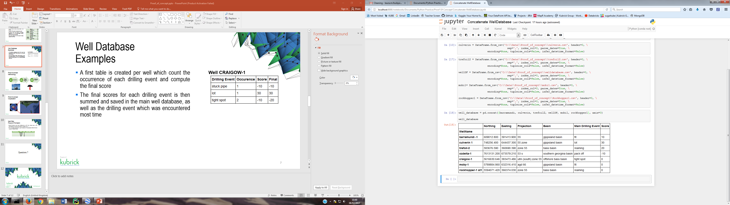
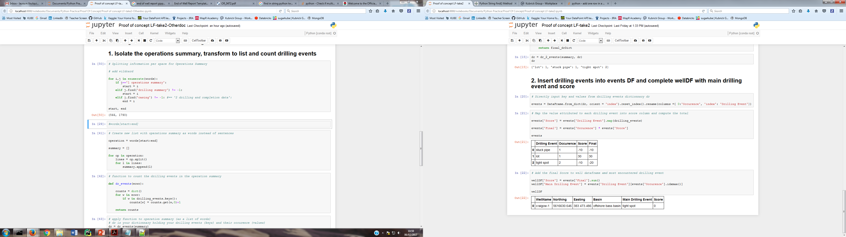
II. Proof of concept Well Database Example
A first table is created per well which count the occurrence of each drilling event and compute the final score
The final scores for each drilling event is then summed and saved in the main well database, as well as the drilling event which was encountered most time
Well CRAIGOW-1

Slide 11
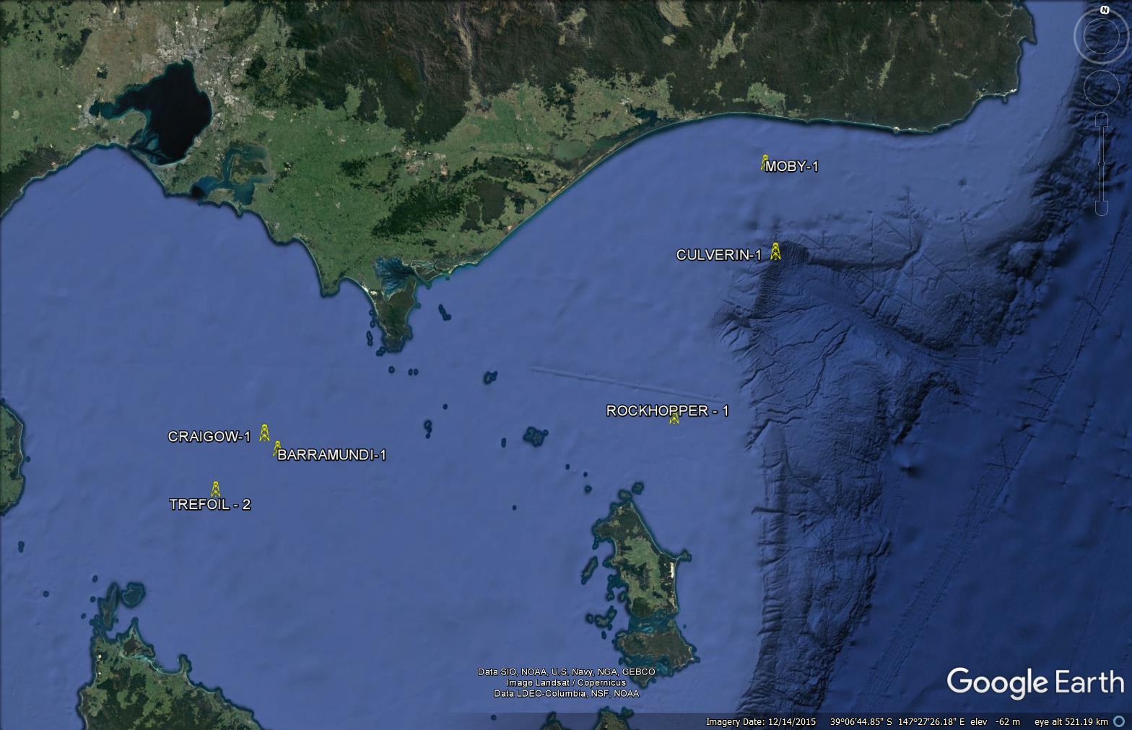
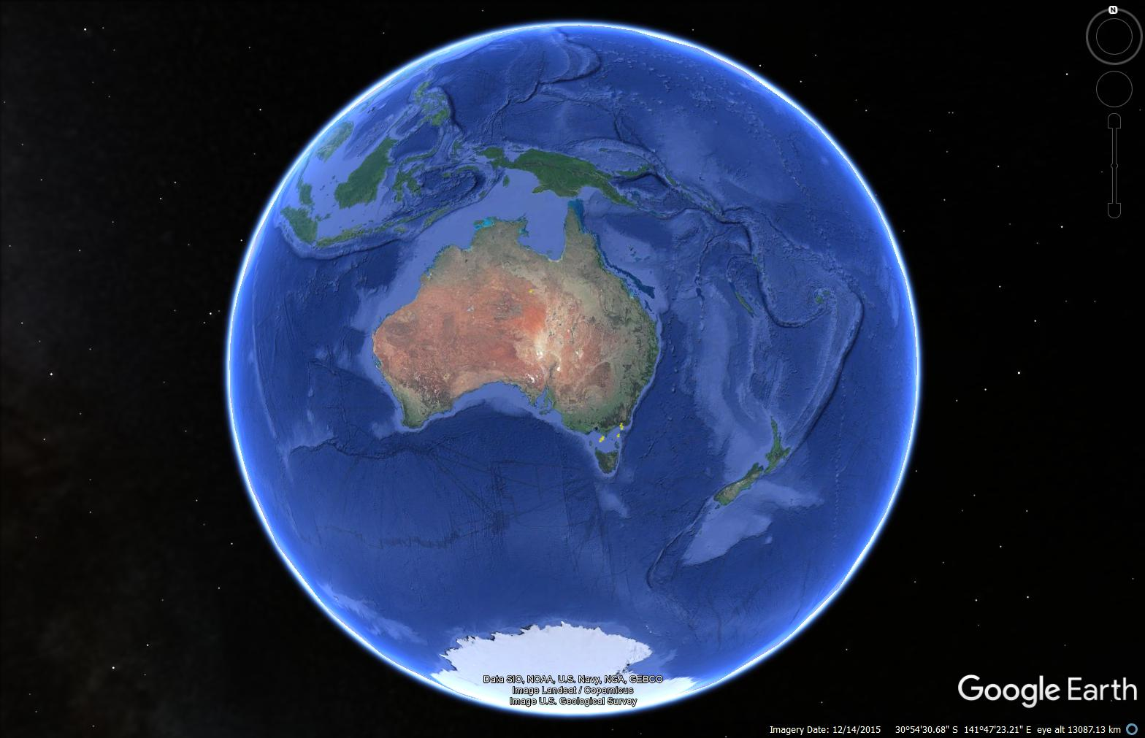
II. Proof of concept Visualisation

Slide 12
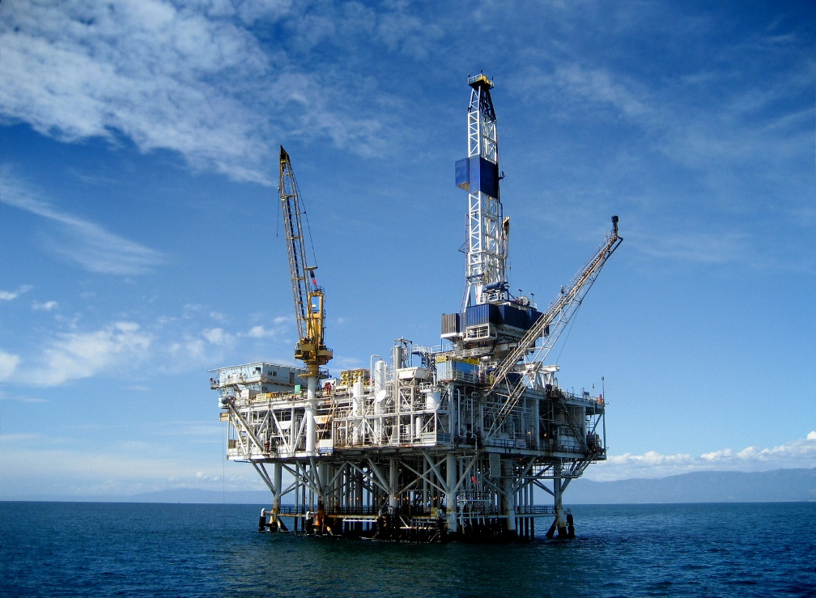

II. Proof of concept Summary
Well Spec.
Coordinates
Well Database
Find the closest wells in the area
Premiums estimation
Challenging area to drill ?

Slide 13
III. Next Step Focus on Formation
Some formation are more challenging to drill than others due to rock parameters and mechanics (density, cohesion, etc …)
From the asset specification: get the details of the expected drilled formation (type and meters drilled)
Formation Name | Type | Risk | Meters Drilled | Score
 | Sandstone | 10
 | Limestone | 30
 | Shales | 50
 | Salt | 80

Slide 14
Questions ?

Slide 15
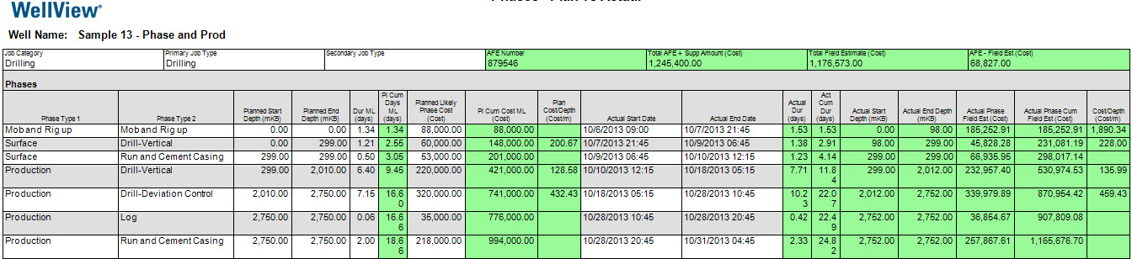
Appendix Proof of concept - Machine learning
Planned costs
Actual costs
Overtime and/or overbudget wells are common in the oil industry
Machine learning
Count type and occurrence of drilling events versus the delay (days) or overbudget ($)
Estimate the weight of each drilling event as a function of days of delay or overbudget
Notes:
Picture: www.peloton.com

Slide 16
Appendix Sample of Available Well Databases
National Data Repository (NDR) : preserve and promote data related to the petroleum exploration and production (E&P) sector
Norway – Diskos NDR
Joint venture consisting of Norwegian Petroleum Directorate (NPD) and oil companies
Kenya – National Data Center
100% government funded
Canada – Data Management Centre
Funded 50/50 by federal and provincial governments (+ funds from industry)
Australia – Geoscience Australia Repository: Wells and Survey
100% government funded
Worldwide – IHS International & Production Database(more than 700,000 wells available)
Owned by IHS
Notes:
https://en.wikipedia.org/wiki/National_Data_Repository
Australia: http://dbforms.ga.gov.au/pls/www/npm.pims_web.search

Slide 17
Appendix Big Data and Cost savings
Deloitte Study for life insurance (2010):
Traditional underwriting: $130 per applicant
Predictive model and big data: $5 per applicant

